Slide 1
R Programming
Basic to Advance
Dr. Kailash Shaw

Slide 2
Basic of R Programming
History of R Programming
R Installation
RStudio IDE
Advantage and Disadvantage
R Packages
R Basic Syntax
R Data Types
R Data Structures
R Variables
R Keywords
R Operators
R Statements
R Loops
R Functions
R If Statement
If-else Statement
else if Statement
R Switch Statement
R Next Statement
R Break Statement
R For Loop
R Repeat Loop
R While Loop
R Functions
R Built-in Functions
R Data Structures
R Vectors
R Lists
R Arrays
R Matrix
R Data Frame
R Factors

Slide 3
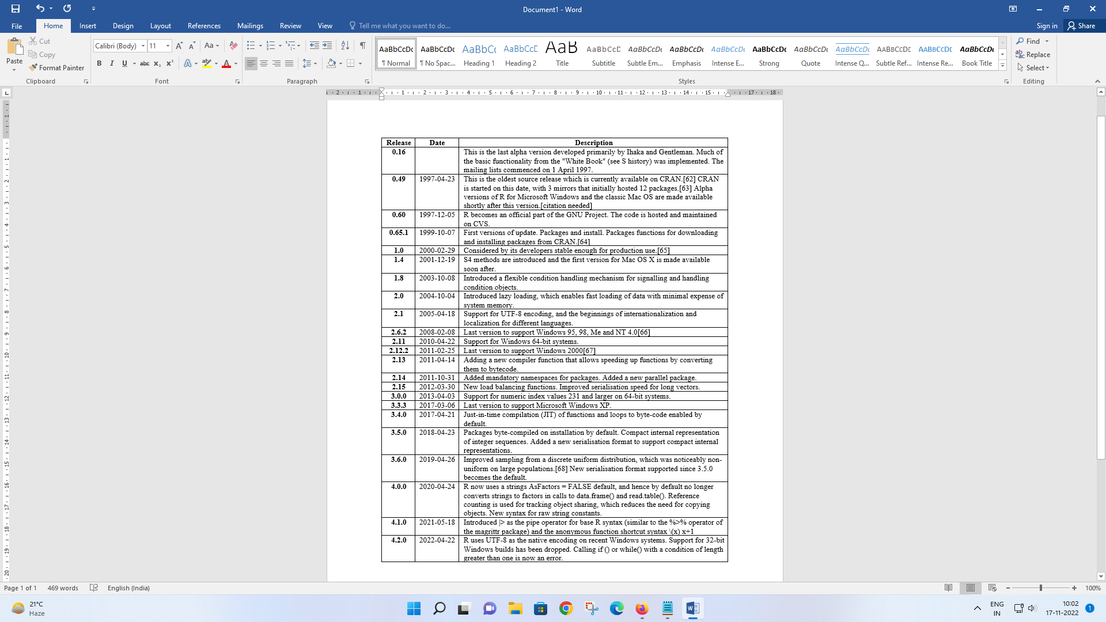
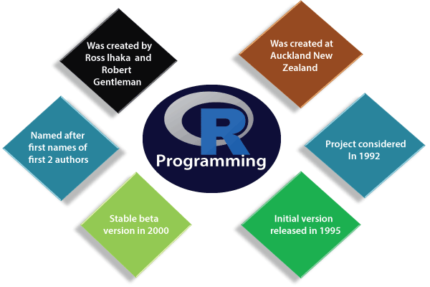
History of R Programming
"R is an interpreted computer programming language which was created by Ross Ihaka and Robert Gentleman at the University of Auckland, New Zealand." The R Development Core Team currently develops R. It is also a software environment used to analyze statistical information, graphical representation, reporting, and data modeling. R is the implementation of the S programming language, which is combined with lexical scoping semantics.

Slide 4
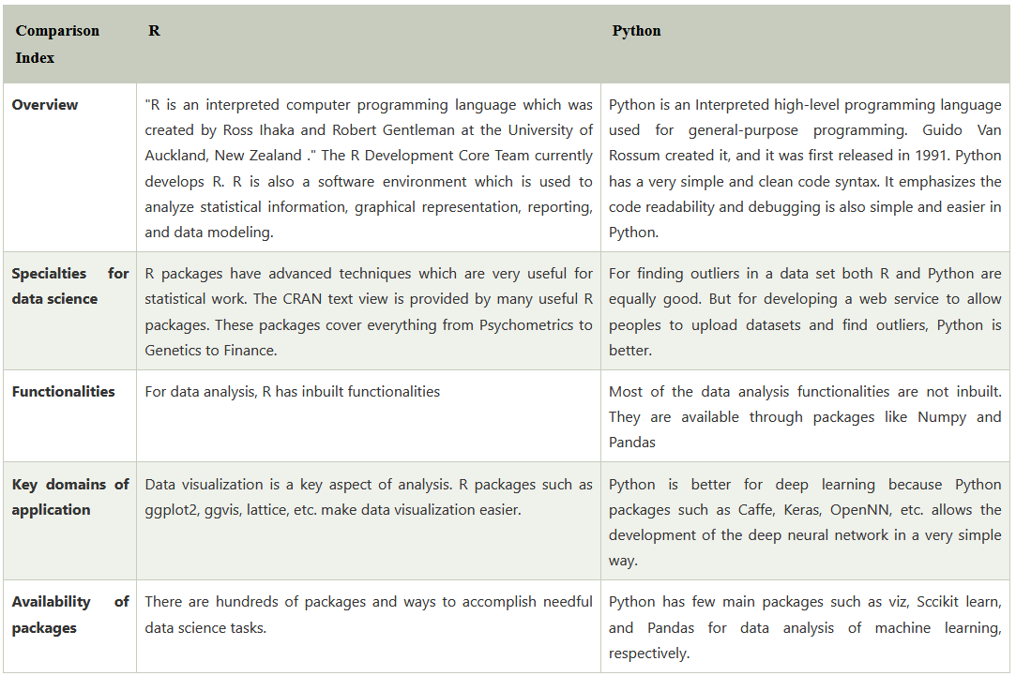
R Vs Python

Slide 5
Application of R
There are several-applications available in real-time. Some of the popular applications are as follows:
E-Commerce.
Healthcare.
Internet Search.
Targeted Advertising.
Website Recommendations.
Advanced Image Recognition.
Speech Recognition.
Airline Route Planning.
Prerequisite
R programming is used for statistical information and data representation. So it is required that we should have the knowledge of statistical theory in mathematics. Understanding of different types of graphs for data representation and most important is that we should have prior knowledge of any programming.

Slide 6
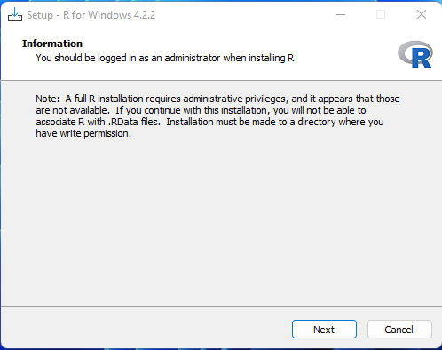
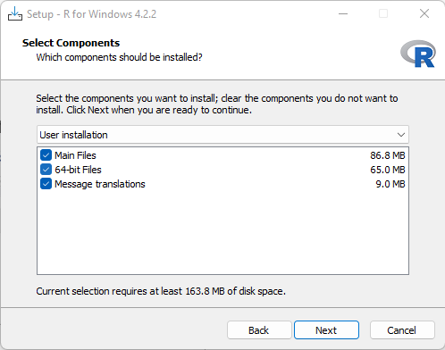
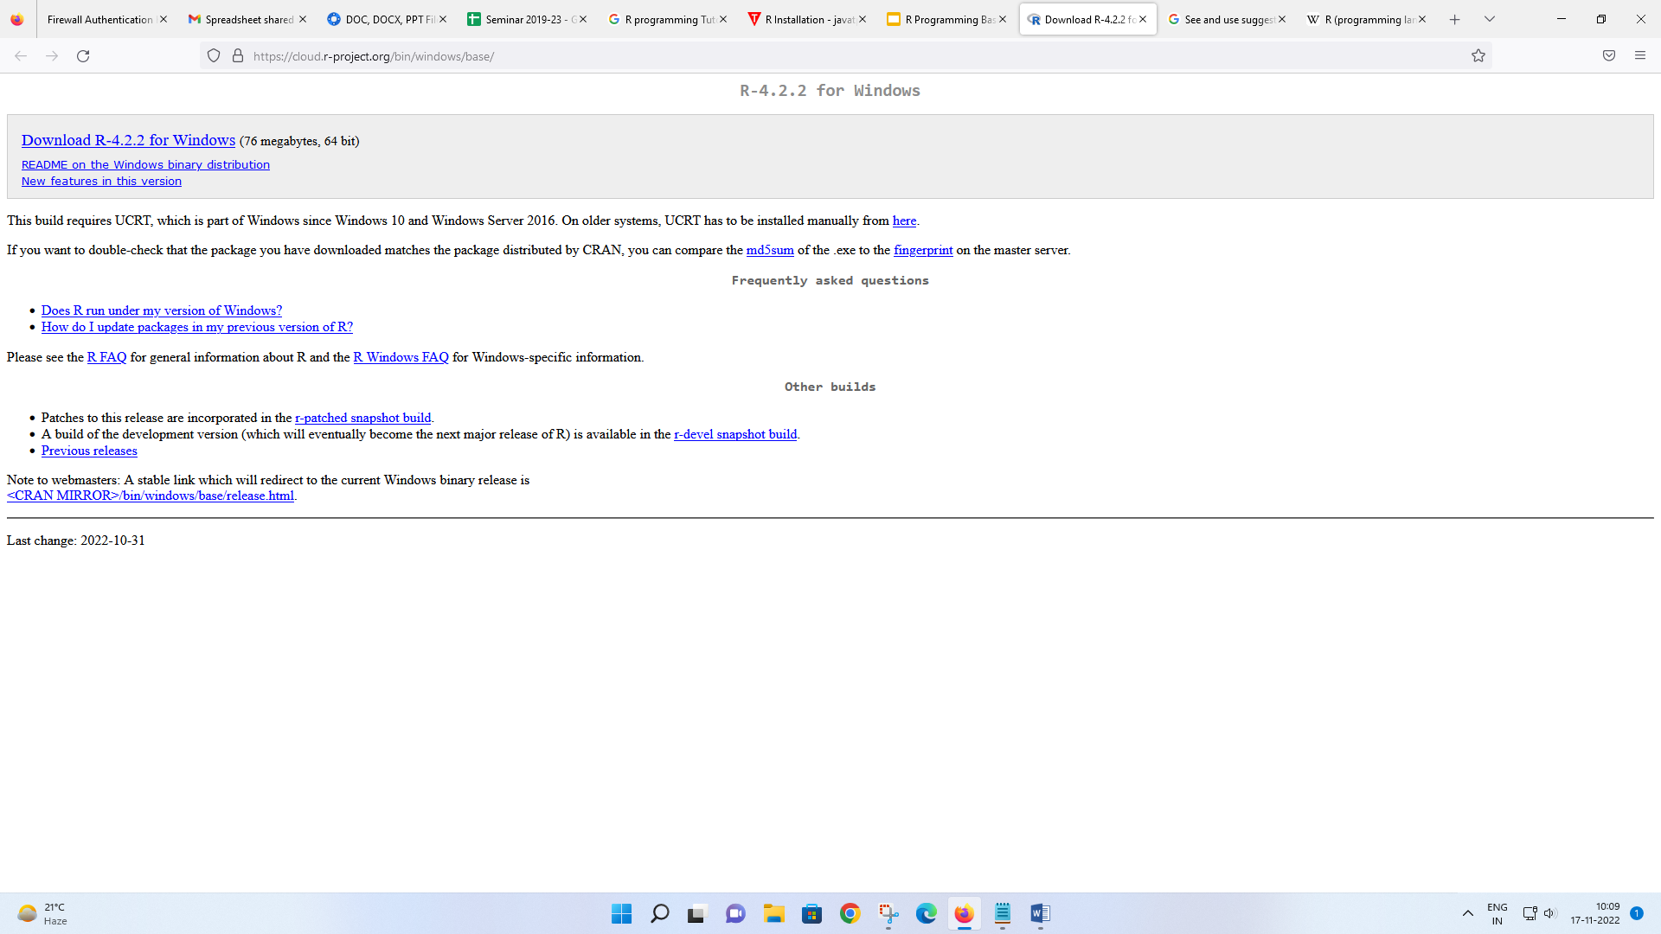
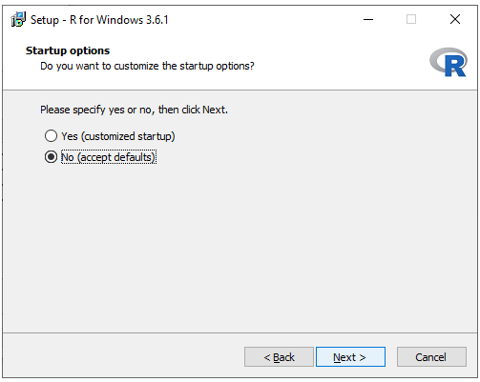
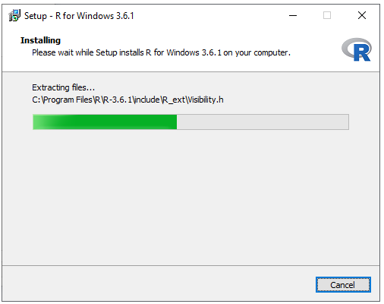
Installation of R Programming
Step 2:
When we click on Download R 4.2.2 for windows, our downloading will be started of R setup. Once the downloading is finished, we have to run the setup of R in the following way:
1) Select the path where we want to download the R and proceed to Next.
Step 1:
First, we have to download the R setup from https://cloud.r-project.org/bin/windows/base/.

Slide 7
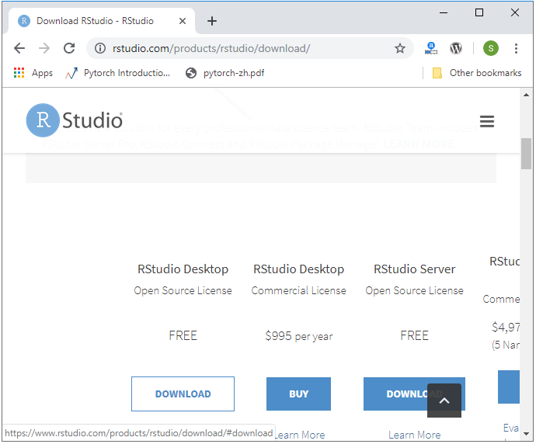
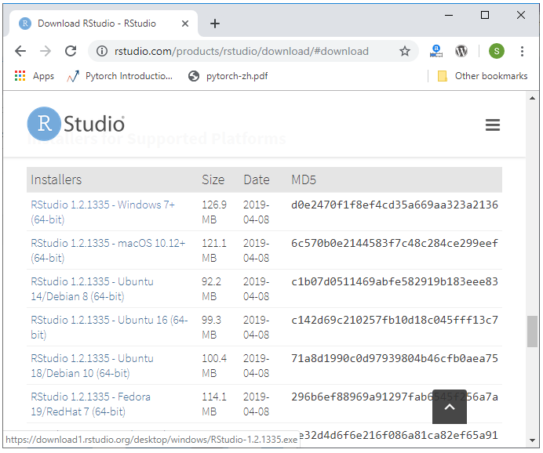
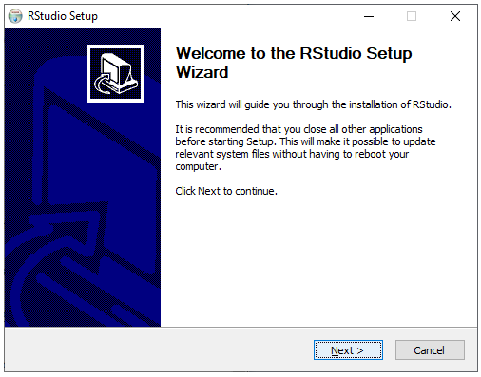
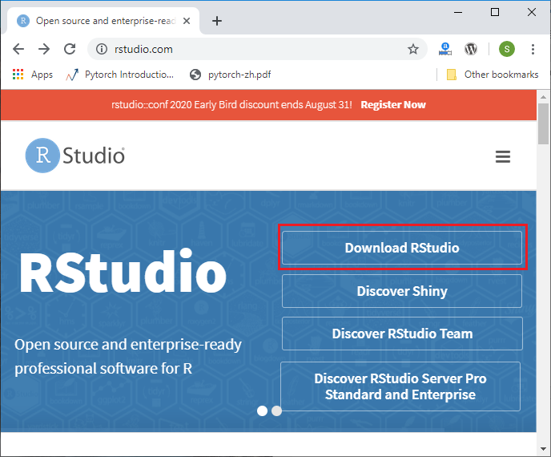
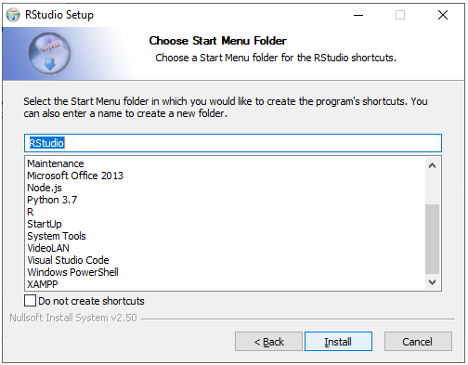
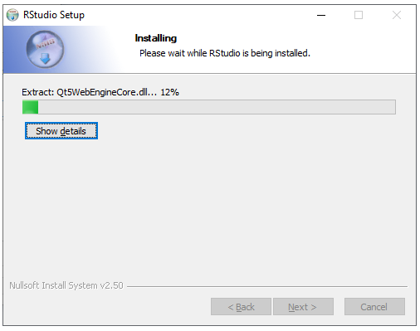
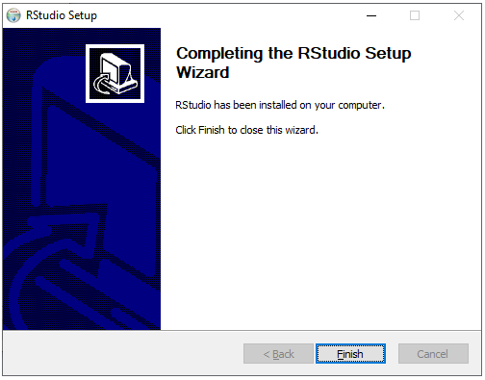
R Studio

Slide 8
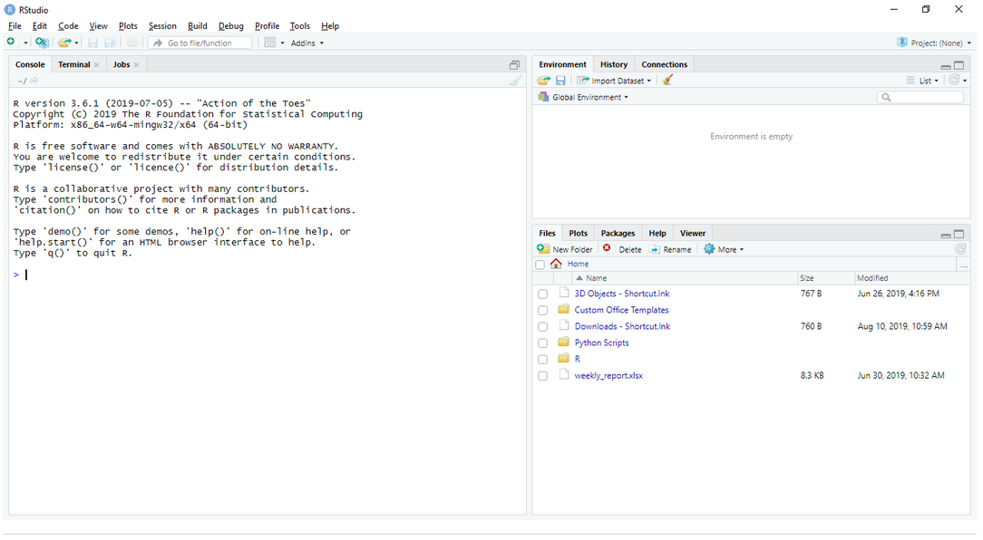
R Studio

Slide 9
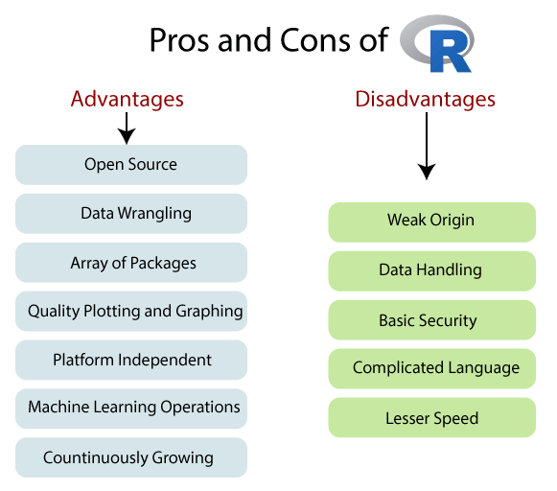
R Advantages and disadvantages

Slide 10
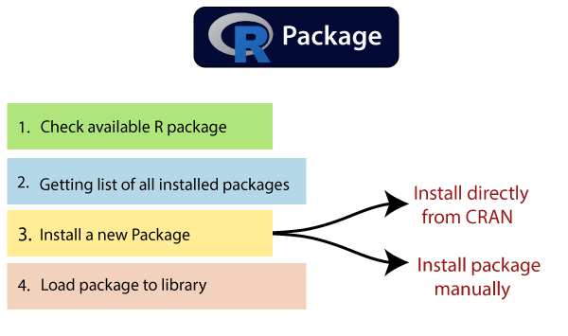
R Packages
R packages are the collection of R functions, sample data, and compile codes. In the R environment, these packages are stored under a directory called "library." During installation, R installs a set of packages. We can add packages later when they are needed for some specific purpose. Only the default packages will be available when we start the R console. Other packages which are already installed will be loaded explicitly to be used by the R program.
There is the following list of commands to be used to check, verify, and use the R packages.
library()
install.packages("Package Name")
The syntax of installing XML package is as follows:
install.packages("XML")
search()

Slide 11
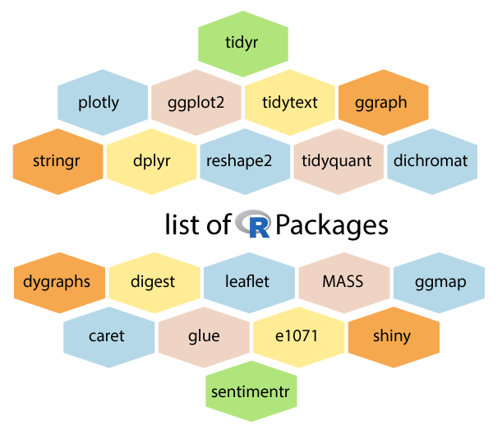
List of R Packages

Slide 12
R Script File
#My First program in R programming
string <-"Hello World!"
print(string)
Write a Program using R to compute SI and CI using following information
P = 1500
T = 9
R =8.6%
N = 4 (Quarterly Interest applied)

Slide 13
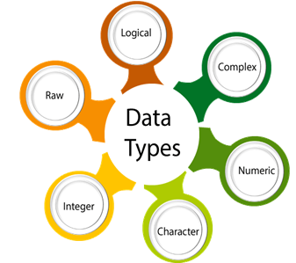
Data Type in R Programming
Data Type | Example | Description
Logical | TRUE, FALSE | boolean values
Numeric | 2, 45.9, 3782 | Numbers of all kinds
Integer | 9L, 779L | Explicitly Integers
Complex | 8+9i | Real Value + Complex Value
Character | ‘m’, “hello” | Characters and Strings
Raw | [68, 65, 6C, 6C,6F] is the value for string hello. | Any data is stored as raw bytes

Slide 14
#Logical Data type
variable_logical<- TRUE
cat(variable_logical,"\n")
cat("The data type of variable_logical is ",class(variable_logical),"\n\n")
#Numeric Data type
variable_numeric<- 3532
cat(variable_numeric,"\n")
cat("The data type of variable_numeric is ",class(variable_numeric),"\n\n")
#Integer Data type
variable_integer<- 133L
cat(variable_integer,"\n")
cat("The data type of variable_integer is ",class(variable_integer),"\n\n")
#Complex Data type
variable_complex<- 3+2i
cat(variable_complex,"\n")
cat("The data type of variable_complex is ",class(variable_complex),"\n\n")
#Raw Data type
variable_raw<- charToRaw("Learning r programming")
cat(variable_raw,"\n")
cat("The data type of variable_char is ",class(variable_raw),"\n\n")
#Character Data type
variable_char<- "Learning r programming"
cat(variable_char,"\n")
cat("The data type of variable_char is ",class(variable_char),"\n\n")

Slide 15

Data Structure in R programming

Slide 16
Vectors
Vectors
A vector is the basic data structure in R, or we can say vectors are the most basic R data objects. There are six types of atomic vectors such as logical, integer, character, double, and raw. "A vector is a collection of elements which is most commonly of mode character, integer, logical or numeric“
Example Try and Run
c(5,10)/5
X <-c(5,10)
x/5
3. c(1:10) vs c(1,2,3,4,5,6,7,8,910)
Challenge
Now can you create a vector from 10 to 1
Create a Vector with repeated value and display unique one.
Find the Minimum, Maximum, sum, mean, value in a vector
Can You change the value of any element of vector

Slide 17
Lists
List
"A list is a special type of vector in which each element can be a different type.“
Or collection of diffreent data types
Movie <- list(‘pushpa’, 2021, ‘Bahubali’, 2019’, c(‘animation’, ‘adventure’,’comedy’))
Challenge
Can you able to print the 2nd element
Can you able to find the length of list
Can you able to update the making year of pushpa movie to 2020
Naming list variable
Movie <- list( name = ‘pushpa’, year = 2021, genre = c(‘animation’, ‘adventure’,’comedy’))
Print and see what difference you are getting
Try Movie[3] and Movie$genre
You can add element Movie[age]<-2 (Identify error)
If you wish to remove then assign NULL value: Check Your self

Slide 18
Arrays
"An array is a collection of a similar data type with contiguous memory allocation." Suppose, if we create an array of dimension (2, 3, 4) then it creates four rectangular matrices of two rows and three columns.
In R, an array is created with the help of array() function. This function takes a vector as an input and uses the value in the dim parameter to create an array.
m<-c('pushpa','bahubali','jumanji','Avtar’)
ma<-array(m,dim=c(2,2))
ma
Try
ma[1,]
ma[,2]
ma[1,2]

Slide 19
Matrix
A matrix is an R object in which the elements are arranged in a two-dimensional rectangular layout. In the matrix, elements of the same atomic types are contained. For mathematical calculation, this can use a matrix containing the numeric element. A matrix is created with the help of the matrix() function in R.
m<-c('pushpa','bahubali','jumanji','Avtar’)
ma<-matrix(m, nrow=2, ncol=2)
ma
Try
ma[1,]
ma[,2]
ma[1,2]
Challenge
Can you identify the difference in output of Array and Matrix
Try adding one more parameter byrow=TRUE and see the difference
Can you print the subset of two range

Slide 20
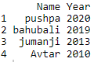
Data Frames
Data Frames
A data frame is a two-dimensional array-like structure, or we can say it is a table in which each column contains the value of one variable, and row contains the set of value from each column.
There are the following characteristics of a data frame:
d<-data.frame(Name=c('pushpa','bahubali','jumanji','Avtar'),
Year=c(2020,2019,2013,2010))
d[1,]
Head[d]
Tail [d]
Challenge
1, Can you add one more column in the d say age=c(2,3,10,12)
Try adding one row by using rbind function; d = rbind(d, c(name=‘spiderman’, Year=2005, age=17)
Challenge let delete Row 5 from the d Try d<-d[-5,] Now can you delete column Try d[age]=NULL

Slide 21
Factors
Factors
Factors are also data objects that are used to categorize the data and store it as levels. Factors can store both strings and integers. Columns have a limited number of unique values so that factors are very useful in columns. It is very useful in data analysis for statistical modeling.
Factors are created with the help of factor() function by taking a vector as an input parameter.

Slide 22
https://docs.google.com/forms/d/1MS7bSHqgCBohTucM40vmz9AkfYB95UQQUyqHWaS0wGw/edit
If you score more then 80% then you are pass else fail

Slide 23
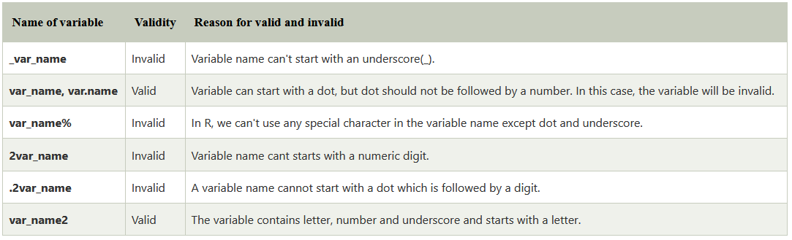
Variables in R programming

Slide 24
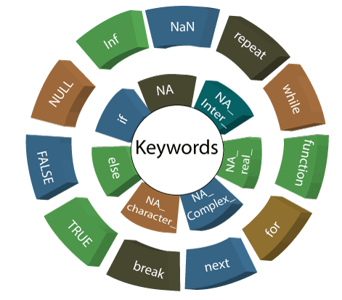
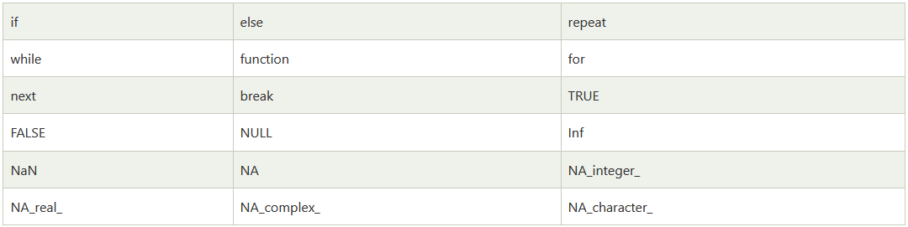
Keywords in R programming

Slide 25
R Operators
Arithmetic, Relational, Logical, Assignment and some of the Miscellaneous Operators that R programming language provides.
Arithmetic Operators | + | - | * | %% | ^
Relational Operators | < | > | == | >=/<= | !=
Logical Operators | & | | | ! | && | ||
Assignment Operators | = | <- | -> | <<- | ->>
Misc. Operators | : | %in% | %*%

Slide 26
Operators
Operator | Description | Usage
+ | Addition of two operands | a + b
– | Subtraction of second operand from first | a – b
* | Multiplication of two operands | a * b
/ | Division of first operand with second | a / b
%% | Remainder from division of first operand with second | a %% b
%/% | Quotient from division of first operand with second | a %/% b
^ | First operand raised to the power of second operand | a^b

Slide 27
An example for each of the arithmetic operator on Numerical values is provided below.
Output
a <- 7.5
b <- 2
print ( a+b ) #addition
print ( a-b ) #subtraction
print ( a*b ) #multiplication
print ( a/b ) #Division
print ( a%%b ) #Reminder
print ( a%/%b ) #Quotient
print ( a^b ) #Power of
$ Rscript r_op_arithmetic.R [1] 9.5 [1] 5.5 [1] 15 [1] 3.75 [1] 1.5 [1] 3 [1] 56.25

Slide 28
An example for each of the arithmetic operator on Vectors is provided below.
Output
$ Rscript r_op_arithmetic_vector.R [1] 10 13 11 [1] 6 5 1 [1] 16 36 30 [1] 4.00 2.25 1.20 [1] 0 1 1 [1] 4 2 1 [1] 64 6561 7776
# R Operators - R Arithmetic Operators Example for vectors
a <- c(8, 9, 6)
b <- c(2, 4, 5)
print ( a+b ) #addition
print ( a-b ) #subtraction
print ( a*b ) #multiplication
print ( a/b ) #Division
print ( a%%b ) #Reminder
print ( a%/%b ) #Quotient
print ( a^b ) #Power of

Slide 29
Following are the six relational operations R programming language supports.The output is boolean (TRUE or FALSE)
Operator | Description | Usage
< | Is first operand less than second operand | a < b
> | Is first operand greater than second operand | a > b
== | Is first operand equal to second operand | a == b
<= | Is first operand less than or equal to second operand | a <= b
>= | Is first operand greater than or equal to second operand | a > = b
!= | Is first operand not equal to second operand | a!=b

Slide 30
An example for each of the relational operator on Numberical values is provided below.
# R Operators - R Relational Operators Example for Numbers
a <- 7.5
b <- 2
print ( ab ) # greater than
print ( a==b ) # equal to
print ( a<=b ) # less than or equal to
print ( a>=b ) # greater than or equal to
print ( a!=b ) # not equal to
Output
$ Rscript r_op_relational.R [1] FALSE [1] TRUE [1] FALSE [1] FALSE [1] TRUE [1] TRUE

Slide 31
An example for each of the relational operator on Vectors is provided below.
# R Operators - R Relational Operators Example for Numbers
a <- c(7.5, 3, 5)
b <- c(2, 7, 0)
print ( a<b ) # less than
print ( a>b ) # greater than
print ( a==b ) # equal to
print ( a<=b ) # less than or equal to
print ( a>=b ) # greater than or equal to
print ( a!=b ) # not equal to
Output
$ Rscript r_op_relational_vector.R [1] FALSE TRUE FALSE [1] TRUE FALSE TRUE [1] FALSE FALSE FALSE [1] FALSE TRUE FALSE [1] TRUE FALSE TRUE [1] TRUE TRUE TRUE

Slide 32
R Logical Operators
Logical Operators in R programming language work only for the basic data types logical, numeric and complex and vectors of these basic data types.
Operator | Description | Usage
& | Element wise logical AND operation. | a & b
| | Element wise logical OR operation. | a | b
! | Element wise logical NOT operation. | !a
&& | Operand wise logical AND operation. | a && b
|| | Operand wise logical OR operation. | a || b

Slide 33
An example for each of the logical operators on Numerical values is provided below.
# R Operators - R Logical Operators Example for basic logical elements
a <- 0 # logical FALSE
b <- 2 # logical TRUE
print ( a & b ) # logical AND element wise
print ( a | b ) # logical OR element wise
print ( !a ) # logical NOT element wise
print ( a && b ) # logical AND consolidated for all elements
print ( a || b ) # logical OR consolidated for all elements
Output
$ Rscript r_op_logical.R [1] FALSE [1] TRUE [1] TRUE [1] FALSE [1] TRUE

Slide 34
An example for each of the logical operators on Vectors is provided below.
# R Operators - R Logical Operators Example for boolean vectors
a <- c(TRUE, TRUE, FALSE, FALSE)
b <- c(TRUE, FALSE, TRUE, FALSE)
print ( a & b ) # logical AND element wise
print ( a | b ) # logical OR element wise
print ( !a ) # logical NOT element wise
print ( a && b ) # logical AND consolidated for all elements
print ( a || b ) # logical OR consolidated for all elements
Output
$ Rscript r_op_logical_vector.R [1] TRUE FALSE FALSE FALSE [1] TRUE TRUE TRUE FALSE [1] FALSE FALSE TRUE TRUE [1] TRUE [1] TRUE

Slide 35
An example for each of the assignment operators is provided below.
# R Operators - R Assignment Operators
a = 2
print ( a )
a <- TRUE
print ( a )
454 -> a
print ( a )
a <<- 2.9
print ( a )
c(6, 8, 9) -> a
print ( a )
Output
[1] 2
[1] TRUE
[1] 454
[1] 2.9
[1] 6 8 9

Slide 36
R Miscellaneous Operators
Operator | Description | Usage
: | Creates series of numbers from left operand to right operand | a:b
%in% | Identifies if an element(a) belongs to a vector(b) | a %in% b
%*% | Performs multiplication of a vector with its transpose | A %*% t(A)

Slide 37
R Decision Making
In R programming, Decision Making statements help to decide whether to execute a block of code or not, based on a condition. Decision making is an important aspect in any programming language. Decision Making statements are also called Conditional statement.
R If statement executes a set of statements based on a given condition. If the condition in If-statement evaluates to TRUE, then the statements in the If block execute, else not.
In this tutorial, we will learn about R If statement and how does this help in decision making with syntax, flow diagram and examples.

Slide 38
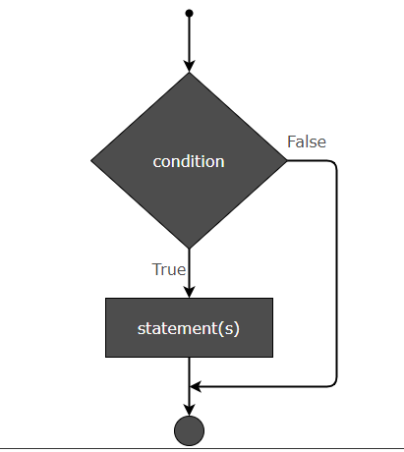
Flow Diagram
R Decision Making
The flow diagram that shows the flow of execution for an if statement is given below.

Slide 39
R Decision Making
Syntax
The syntax of R If statement is
if (condition) {
statement1
statement2 . . .
Statement N
}

Slide 40
Example.R
R Decision Making
a <- 6 if (a == 6) { print ("Value in a is 6.") } print("End of program.")
Output
[1] "Value in a is 6." [1] "End of program."

Slide 41
Check if Number is Even using If
R Decision Making
In this example, we use If-statement to check if a number is even. If n is the number, then If-condition could be n%%2 == 0.
Example.R
n <- 10 if (n %% 2 == 0) { print ("Number is even.") }
Output
[1] "Number is even and divisible by 3."

Slide 42
R Decision Making
Example.R
Using AND Operator in IF Condition
In this example, we check if given number is even and divisible by 3. Since the number has to satisfy both the conditions, we may join the condition using AND operator.
n <- 12 if ((n %% 2 == 0) && (n %% 3 == 0)) { print ("Number is even and divisible by 3.") }
Output
[1] "Number is even and divisible by 3."

Slide 43
R Decision Making
n <- 11 if (!(n %% 2 == 0)) { print ("Number is not even.") }
Output
[1] "Number is not even."

Slide 44
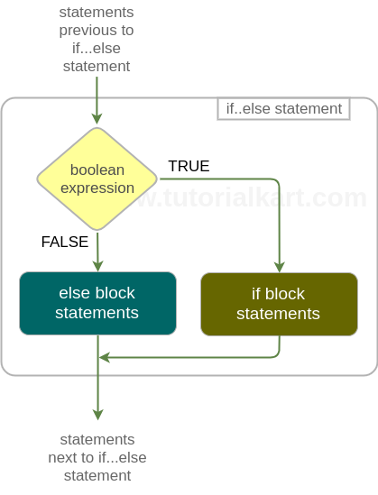
R Decision Making
if(boolean_expression){ if_block_statements } else { else_block_statements }

Slide 45
R Decision Making
# R if..else statement Example
# for TRUE condition
a = 6
if(a==6){
print ("Condition a==6 is TRUE")
print ("This is second statement in if block")
} else{
print ("Condition a==6 is FALSE")
print ("This is second statement in else block")
}
# for FALSE condition
b = 7
if(b==6){
print ("Condition b==6 is TRUE")
print ("This is second statement in if block")
} else{
print ("Condition b==6 is FALSE")
print ("This is second statement in else block")
}
Output
$ Rscript r_if_else_example.R [1] "Condition a==6 is TRUE" [1] "This is second statement in if block" [1] "Condition b==6 is FALSE" [1] "This is second statement in else block"

Slide 46
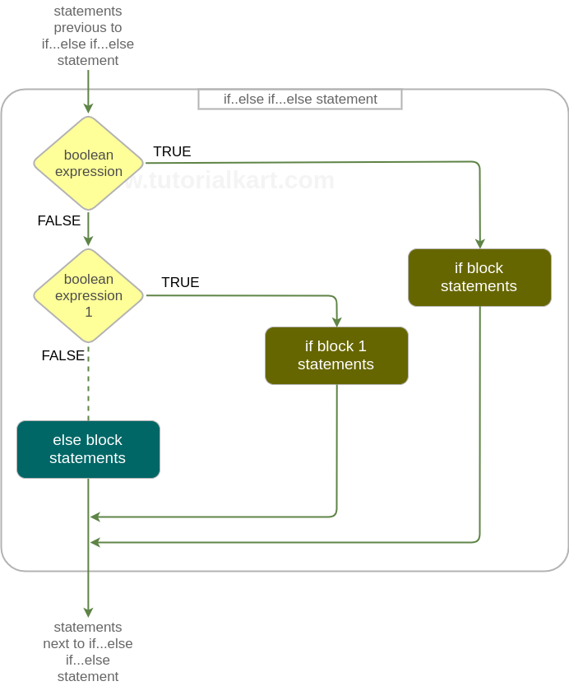
R Decision Making

Slide 47
Example 1 – R If Else If
R Decision Making
Output
b = 7
if(b==6){
print ("Condition b==6 is TRUE")
} else if(b==7){
print ("Condition b==7 is TRUE")
} else if(b==8){
print ("Condition b==8 is TRUE")
} else{
print ("No if condition is TRUE for b")
}
$ Rscript r_if_else_if_else_example.R [1] "Condition b==7 is TRUE"

Slide 48
R Decision Making
Switch based on Index
The syntax of Switch statement which selects one of the cases based on index is
R switch statement selects one of the cases, based on the value of an expression.
There are two ways in which one of the cases is selected: based on index or matching value.
Switch based on Index – If the cases are just values and the expression evaluates to a number, then the expression’s value is used as index to select the case.
Switch based on Matching Value – If cases have both case value and output value like case_1=value1, then the expression value is matched against cases. When there is a match with a case, the corresponding value is the output.
switch(expression, value1, value2, value3, ...)

Slide 49
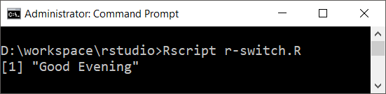
Example 1
R Decision Making
In this example, we will use switch statement based on index. The value of y, is taken as index.
y <- 3
x <- switch(
y,
"Good Morning",
"Good Afternoon",
"Good Evening",
"Good Night"
)
print(x)
Output

Slide 50
Switch based on Matching Value
R Decision Making
The syntax of switch statement based on matching value is
switch(expression, case1=value1, case2=value2, ..., caseN=valueN)

Slide 51
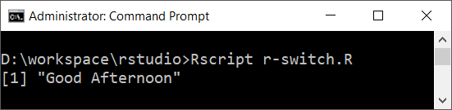
R Decision Making
Example 1
In this example, we will write a switch statement that selects on of the many values by matching expression’s value with the cases.
y <- "12"
x <- switch(
y,
"9"="Good Morning",
"12"="Good Afternoon",
"18"="Good Evening",
"21"="Good Night"
)
print(x)
Output

Slide 52
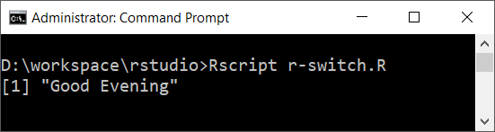
Example 2
In the following R switch statement, we used a string concatenation expression.
a <- "1" b <- "8" x <- switch( paste(a,b,sep=""), "9"="Good Morning", "12"="Good Afternoon", "18"="Good Evening", "21"="Good Night" ) print(x)
Output

Slide 53
Function

Slide 54
Advance Part of R Programming

Slide 55
Reading XLS / CSV file
Read.csv(“File Path with extension”)
For reading xls file
Install.packages(“readxl”)
Library(readxl)
Read_excel(“File Path with extension”)
Try
Built in dataset
Just Type
data()
Help(“data set name”)
Datasetname to load it in memory

Slide 56
Reading Text file
Text<-readLines(“path of the file with extension”)
Now check following
length(text)
Nchar(text)
File.size(“path of file with extension”)
Challenge
Can you identify what will happen if write scan() inplace of readLine()

Slide 57
HTTP

Slide 58
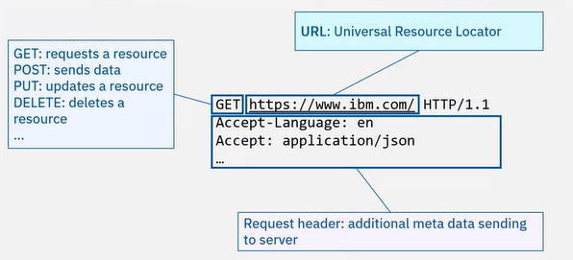
HTTP Request

Slide 59
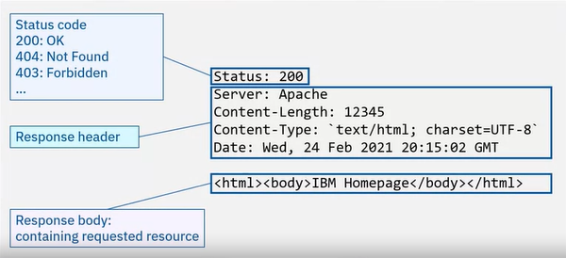
HTTP Response

Slide 60
Exploratory Data Analysis (EDA)
Exploratory Data Analysis (EDA) is the process of analyzing and visualizing the data to get a better understanding of the data and glean insight from it. There are various steps involved when doing EDA but the following are the common steps that a data analyst can take when performing EDA:
Import the data
Clean the data
Process the data
Visualize the data
Package to be used
Tidyverse package for tidying up the data set
ggplot2 package for visualizations
corrplot package for correlation plot
Some other basic functions to manipulate data like strsplit (), cbind (), matrix () and so on.

Slide 61
https://towardsdatascience.com/exploratory-data-analysis-in-r-for-beginners-fe031add7072
https://www.edureka.co/blog/support-vector-machine-in-r/

Slide 62
install.packages("caret")
library('caret')
heart <- read.csv("/cloud/project/heart.csv", sep = ',', header = FALSE)
str(heart)
head(heart)
intrain <- createDataPartition(y = heart$V14, p= 0.7, list = FALSE)
training <- heart[intrain,]
testing <- heart[-intrain,]
dim(training);
dim(testing);
anyNA(heart)
summary(heart)
training[["V14"]] = factor(training[["V14"]])
trctrl <- trainControl(method = "repeatedcv", number = 10, repeats = 3)
svm_Linear <- train(V14 ~., data = training, method = "svmLinear",trControl=trctrl,preProcess = c("center", "scale"), tuneLength = 10)
svm_Lineartest_pred <- predict(svm_Linear, newdata = testing)
test_predconfusionMatrix(table(test_pred, testing$V14))
plot(svm_Linear, main="Linear")

Slide 63
grid <- expand.grid(C = c(0,0.01, 0.05, 0.1, 0.25, 0.5, 0.75, 1, 1.25, 1.5, 1.75, 2,5))
svm_Linear_Grid <- train(V14 ~., data = training, method = "svmLinear", trControl=trctrl, preProcess = c("center", "scale"), tuneGrid = grid, tuneLength = 10)
svm_Linear_Gridplot(svm_Linear_Grid, main="Grid")

